Slide 1
An alternative approach to creating ACE data files for use in Monte Carlo Codes
¹A.Trkov, ²D.E. Cullen
¹ International Atomic Energy Agency, Vienna, Austria
² 1466 Hudson Way, Livermore, CA 94550, U.S.A.

Slide 2
Motivation
Currently, most application libraries are generated with the NJOY system
Strong desire in Member States to have access to "open source" code system
PREPRO can produce multi-band parameters (MB) for self-shielding
NJOY treats self-shielding by the probability table method (PTM)
Can MB be used in Monte Carlo (MC) and deterministic calculations?

Slide 3
Objective
Demonstrate that two-band MB parameters can be substituted for PTM in ACE
No change to MCNP needed
Results of criticality calculations remain practically unaffected

Slide 4
Procedure
Calculate self-shielded cross sections with PURR of NJOY2012
Convert cross sections to two-band parameters (URRDO code)
Replace PTM parameters with MB
Proceed with NJOY to create ACE file

Slide 5
Testing
Benchmark selection criteria
Sensitive to capture & fission of ²³⁵U, ²³⁸U
Sensitive to ²³⁸U capture in 10-20 keV range (list provided by O. Cabellos)
Availability of MCNP inputs
List includes 32 benchmarks from ICSBEP

Slide 6
Testing (Cont.)
Calculations
Straight NJOY processing of 235U, 238U to make the reference case
Same as above but substituting parameters that give “no self-shielding”
Processing with NJOY but substituting PTM parameters with MB parameters

Slide 7
Results
Some benchmarks show sensitivity to self-shielding in URR in excess of 1000 pcm
Differences between PTM and MB less than 20 pcm
Convergence criteria between 8 and 3 pcm

Slide 8
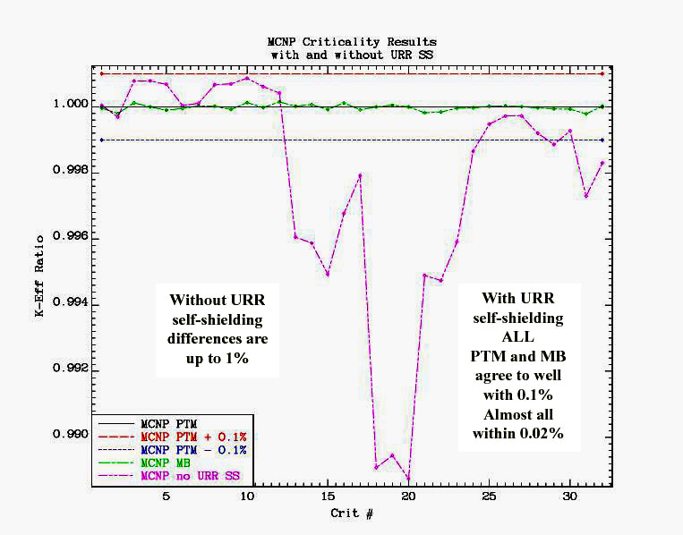

Slide 9
Conclusions
NOT testing the method of generating self-shielded cross sections but
Testing only the replacement of PTM parameters with MB (two-band)
All test cases agree to better than 20 pcm
NO change to MCNP is needed.

Slide 10
Implications
MB and PTM parameters can be used interchangeably
MB representation can be extended to RRR
More compact ACE libraries
Use in deterministic codes – full accuracy on coarse energy grid with minimal computational overhead

